Slide 1
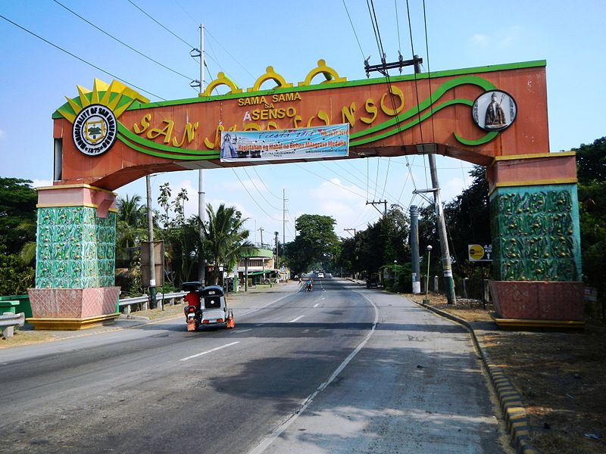

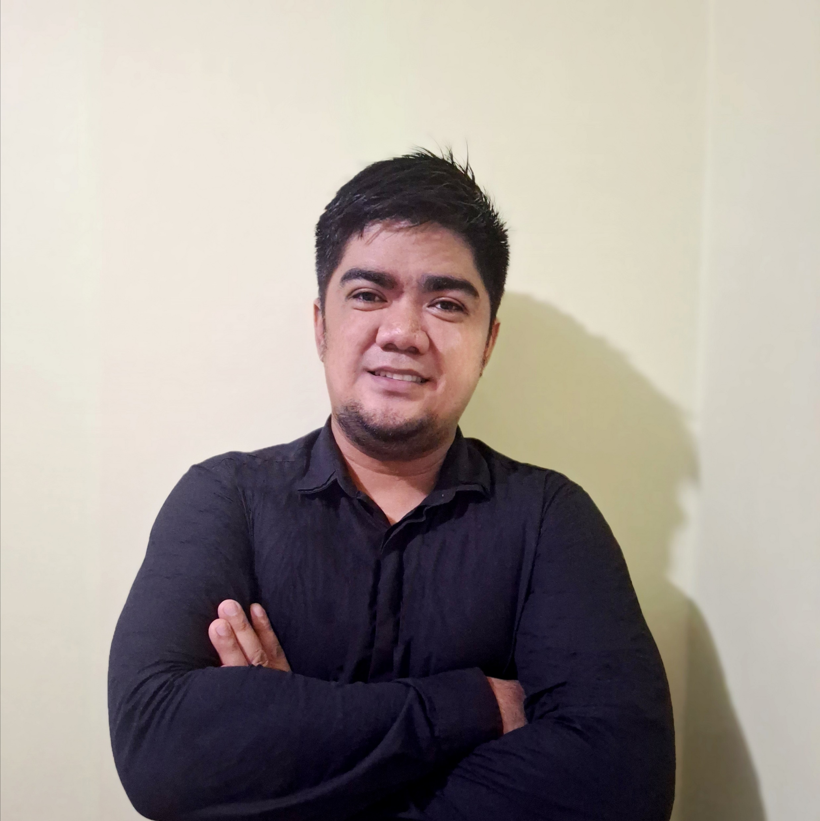

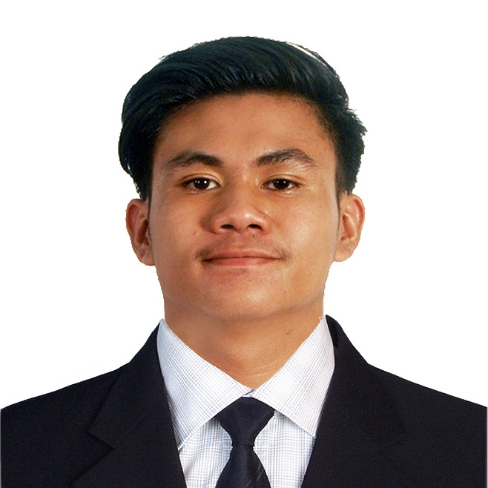
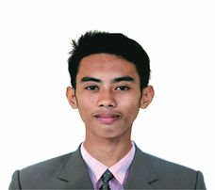
WELCOME!
OUR TEAM
KA-STUDY APP: A SYSTEM-BASED EDUCATIONAL APPLICATION FOR BASC
Kimberly C. Sinaguinan
Project Manager
Data Analyst I
Multimedia III
Ronaldo F. Payawal Jr.
Programmer I
Data Analyst III
Francesca V. Piczon
Multimedia I
Financial Manager
Data Analyst II
Carl Angelo L. Aquino
Programmer II
Multimedia II
Christian S. Arenas
Programmer III

Slide 2

KA-STUDY APP: A SYSTEM-BASED EDUCATIONAL APPLICATION FOR BASC
BARANGAY INFORMATION AND RECORD MANAGEMENT SYSTEM FOR BARANGAY MAASIM, SAN ILDEFONSO, BULACAN

Slide 3
TABLE OF CONTENTS
01
02
OBJECTIVES OF
THE STUDY
SCOPE OF THE
STUDY
03
04
PROJECT DESIGN/DEVELOPMENT PLAN AND METHODOLOGY
LIMITATION OF
THE STUDY

Slide 4

MAIN OBJECTIVES OF THE STUDY
KA-STUDY APP: A SYSTEM-BASED EDUCATIONAL APPLICATION FOR BASC
The main goal of this project is to develop a Barangay Information and Record Management System for Barangay Maasim, San Ildefonso, Bulacan.
BARANGAY MAASIM E-GOVERNANCE: EMPOWERING COMMUNITY THROUGH DIGITAL SOLUTIONS

Slide 5




SPECIFIC OBJECTIVES
SYSTEM
01
02
03
04
KA-STUDY APP: A SYSTEM-BASED EDUCATIONAL APPLICATION FOR BASC
provide a comprehensive dashboard system
Evaluating the system based on ISO/IEC 25010.
Downloadable
Forms
Provide Chat
Assistance
BARANGAY MAASIM E-GOVERNANCE: EMPOWERING COMMUNITY THROUGH DIGITAL SOLUTIONS

Slide 6
SCOPE OF THE
STUDY
User-friendly record management system for Barangay Maasim, San Ildefonso, Bulacan.
Seamless access for registered residents to securely submit information.
01
02
Access to downloadable forms permits, certificate of indigency, residence certificate, clearances.
Special case identification. Persons with Disabilities (PWDs) and seniors
03
04
05
Convenient form submission via chat assistance feature.

Slide 7
LIMITATION OF THE
STUDY
Physical visit required for those lacking gadgets or internet access.
Exclusivity restricts access for non-residents
01
02
03
Client directives limit design flexibility and innovation.

Slide 8




PROGRAM SPECIFICATION
KA-STUDY APP: A SYSTEM-BASED EDUCATIONAL APPLICATION FOR BASC
Organizing Resident Information
Handling Service
request
Storing Data
Securely
Improving communication between officials and residents
BARANGAY MAASIM E-GOVERNANCE: EMPOWERING COMMUNITY THROUGH DIGITAL SOLUTIONS

Slide 9






SOFTWARE SPECIFICATION
BACKEND
FRONTEND
SYSTEM
BARANGAY MAASIM E-GOVERNANCE: EMPOWERING COMMUNITY THROUGH DIGITAL SOLUTIONS

Slide 10




HARDWARE SPECIFICATION
The minimum specifications for workstations are:
KA-STUDY APP: A SYSTEM-BASED EDUCATIONAL APPLICATION FOR BASC
256GB SSD or higher
Ethernet and
Wi-FI Connectivity
Intel i3
8gb RAM
BARANGAY MAASIM E-GOVERNANCE: EMPOWERING COMMUNITY THROUGH DIGITAL SOLUTIONS

Slide 11

AGILE METHODOLOGY (MODEL)
KA-STUDY APP: A SYSTEM-BASED EDUCATIONAL APPLICATION FOR BASC
BARANGAY MAASIM E-GOVERNANCE: EMPOWERING COMMUNITY THROUGH DIGITAL SOLUTIONS

Slide 12

PATIENT AUTOMATED RECORDS AND INFORMATION SYSTEM FOR THE RURAL HEALTH UNIT (RHU) IN BRGY. PINAOD, SAN ILDEFONSO, BULACAN.

Slide 13

OBJECTIVES OF THE STUDY
MAIN OBJECTIVE
The main objective of the study is to develop a web-based patient automated records and information for the rural health unit in Barangay, Pinaod, San Ildefonso Bulacan.

Slide 14
SPECIFICALLY, THE STUDY AIMED TO:
Automate the process of recording and managing patient records by storing them in the system's database and presenting them in the UI of the system.
Develop a user-friendly dashboard interface for patient information records.
01
02
SYSTEM
Evaluate the system's performance according to ISO/IEC 25010 standards, focusing on usability, functionality, accuracy, and interface.
Develop an appointment and scheduling system for the patients of the Rural Health Unit (RHU).
03
04

Slide 15
SCOPE OF THE
STUDY
create a user-friendly health record system for the local RHU
01
02
Improve patient information process
03
04
Community Healthcare improvement
Health Record
management

Slide 16

LIMITATION OF THE STUDY
x
Only apply to the specific Rural health unit.

Slide 17
PROGRAM SPECIFICATION
SYSTEM
01
02
03
Patient registration
Medical history recording
Reporting capabilities

Slide 18
SOFTWARE SPECIFICATION
BACKEND
FRONTEND
SYSTEM

Slide 19

HARDWARE SPECIFICATION
Server Requirements:
Processor: Intel Core i3 or higher
RAM: 4GB or higher
Storage: 250GB SSD/HDD or higher capacity
Client Device Specifications:
Minimum specifications for optimal performance and usability
Networking Infrastructure:
Routers, switches, and internet connectivity specified for seamless communication

Slide 20

METHODOLOGY (MODEL)

Slide 21
THANK YOU
OUR TEAM
KA-STUDY APP: A SYSTEM-BASED EDUCATIONAL APPLICATION FOR BASC
Kimberly C. Sinaguinan
Project Manager
Data Analyst I
Multimedia III
Ronaldo F. Payawal Jr.
Programmer I
Data Analyst III
Francesca V. Piczon
Multimedia I
Financial Manager
Data Analyst II
Carl Angelo L. Aquino
Programmer II
Multimedia II
Christian S. Arenas
Programmer III

